Slide 1
Brute Force
Yanyan Xu

Slide 2
Outline
What is “Brute Force”?
Examples
2.1 Simple enumeration
2.2 Permutation
2.3 Subset Generation

Slide 3
1 What is “Brute Force”?
Brute force是一种非常通用的解决问题的技术，包括系统地列举解决方案的所有可能的候选者，并检查每个候选者是否满足问题的陈述。

Slide 4
Characteristics
虽然暴力算法实现起来很简单，如果存在的话，它总能找到解决方案，但它的成本与候选解决方案的数量成正比——在许多实际问题中，候选解决方案往往会随着问题规模的增加而迅速增长。详尽的

Slide 5
When to use brute force
当问题大小有限时，或者当存在可用于将候选解决方案集减少到可管理的大小的特定问题启发法时，通常会使用蛮力。
当实现的简单性比速度更重要时，也会使用该方法。
例如，在关键应用中，算法中的任何错误都会产生非常严重的后果；或者当使用计算机来证明数学定理时。
在对其他算法进行基准测试时，它也可用作基准方法。

Slide 6
2 Examples
2.1 Simple enumeration
2.2 Permutation
2.3 Subset Generation

Slide 7
2.1 Simple enumeration
Binary Number (hdu 3711)
Division (UVa 725)
Maximum Product (UVa 11059)
Fraction Split (UVa 10976)

Slide 8
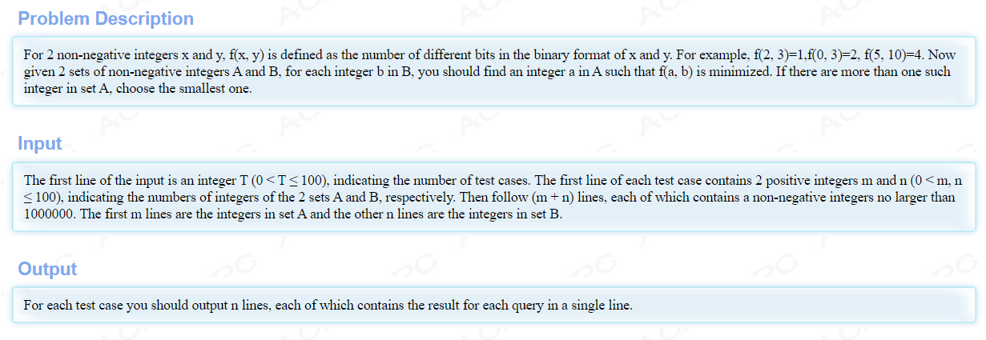
Binary Number

Slide 9
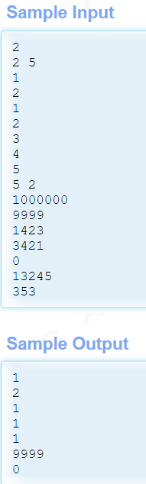

Slide 10
Division

Slide 11
Maximum Product

Slide 12
Fraction Split

Slide 13
2.2 Permutation
Permutations of 1~n
Permutations with repetition
The decision tree
next_permution in STL
Not less than O(n!)

Slide 14
Permutations of 1~n
输入n；按字典顺序输出n从小到大的所有排列
使用递归：首先输出所有排列，从1开始，然后是2，然后是3…
//A是所确定的前缀序列；S是要排列的元素集
void print_permutation(A, S)
{
if(S is empty) Output A;
else Select each element v in S from small to large
{
print_permutation(A+v,S-{v})
}
}

Slide 15
Permutations with repetition
Input array P (There are repeated elements in P);
Output its permutations

Slide 16
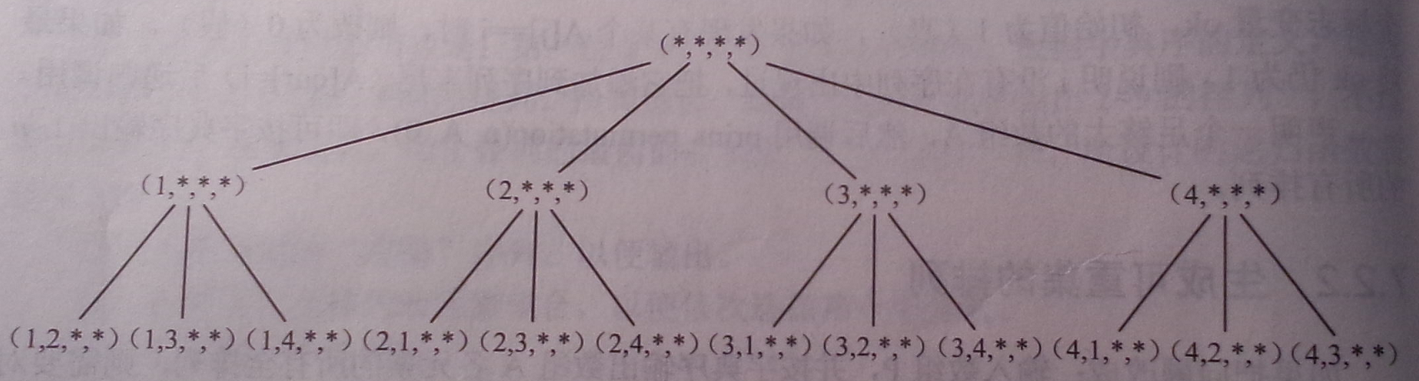
The decision tree-the procedure of recursion
If the solution of a problem can be obtained by multiple steps, and each step has several choices, and it can be achieved by recursive enumeration, then its procedure can be described using a decision tree.

Slide 17
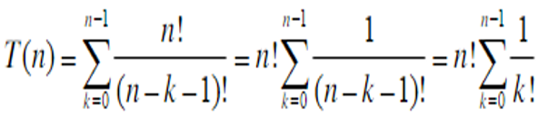
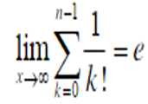
Analysis of the decision tree
depth 0 1 node
depth 1 n nodes
depth 2 n*(n-1) nodes
depth 3 n*(n-1)*(n-2) nodes
…
depth n n! nodes
n*(n-1)*(n-2)*…*(n-k) =
T(n)<n!*e=O(n!)
e≈2.718 Both depth n and depth n-1 have n! nodes, so the number of nodes from depth 0 to depth n-2 < n!, that is, in most cases, the number of nodes from the last two layers in a decision tree plays a decisive role.
CalculateLimit.cpp

Slide 18
next_permution in STL
next_permutation is also suitable for “Permutations with repetition”
Conclusion: recursion or next_permution

Slide 19
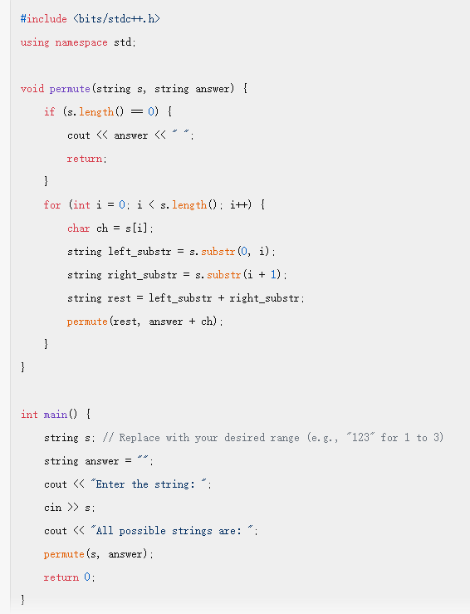
ChatGPT: Program to display permutations of 1~n in C++

Slide 20
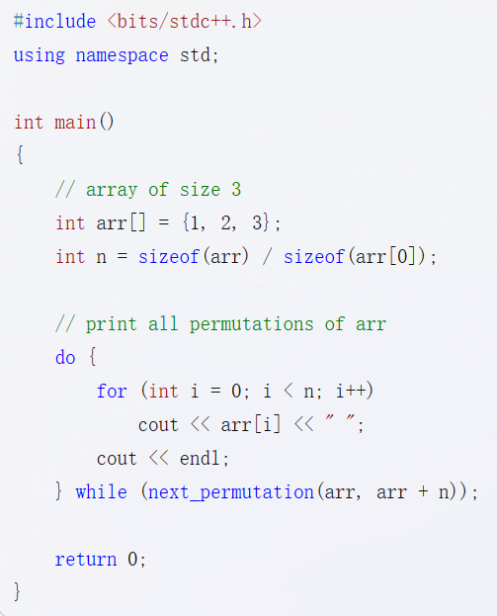
ChatGPT: Program to display permutations of 1~n in C++

Slide 21
2.3 Subset Generation
给定一个集合，找出它的所有子集。集合中没有重复的元素。Incremental construction
Bit vector method
Binary method
Not less than O(2^{n})

Slide 22
Incremental construction
Select one element at a time and place it in the set.

Slide 23
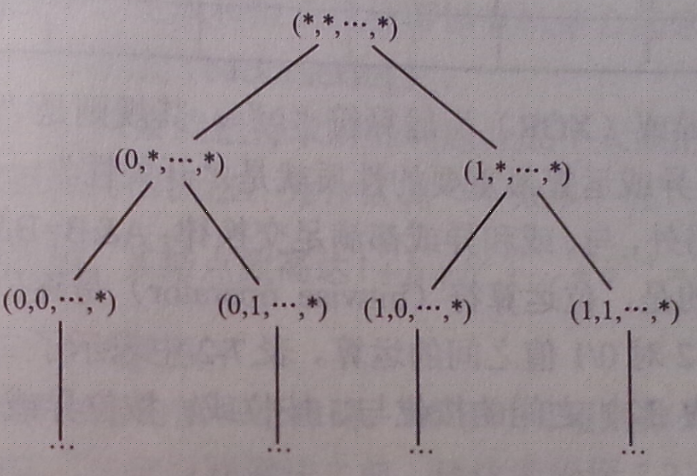
Bit vector method
Construct a bit vector B[i] instead of directly constructing subset A itself.

Slide 24
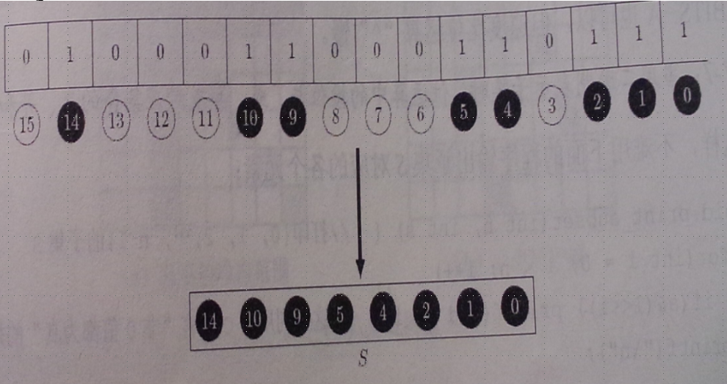
Binary method

